Slide 1
LIS 4404 – Week 2 Agenda
History of Dublin Core
The fifteen Dublin Core elements
Qualified DC
Early metadata on the Web
Where Dublin Core is used
Break
Lab
Notes:
agenda for the lecture, March 24, 2015

Slide 2
History of Dublin Core
Need for simple retrieval of Web documents
Core vocabulary
Easily shared across communities
Notes:
http://dublincore.org/about/history

Slide 3
The Original Fifteen
Title
Creator
Subject
Description
Publisher
Contributors
Date
Type
Format
Identifier
Source
Language
Relation
Coverage
Rights

Slide 4
The Original Fifteen
Title
Creator
Subject
Description
Publisher
Contributors
Date
Type
Format
Identifier
Source
Language
Relation
Coverage
Rights

Slide 5
The Original Fifteen
Title
Creator
Subject
Description
Publisher
Contributors
Date
Type
Format
Identifier
Source
Language
Relation
Coverage
Rights

Slide 6
The Original Fifteen
Title
Creator
Subject
Description
Publisher
Contributors
Date
Type
Format
Identifier
Source
Language
Relation
Coverage
Rights

Slide 7
The Original Fifteen
Title
Creator
Subject
Description
Publisher
Contributors
Date
Type
Format
Identifier
Source
Language
Relation
Coverage
Rights

Slide 8
The Original Fifteen
Title
Creator
Subject
Description
Publisher
Contributors
Date
Type
Format
Identifier
Source
Language
Relation
Coverage
Rights

Slide 9
The Original Fifteen
Title
Creator
Subject
Description
Publisher
Contributors
Date
Type
Format
Identifier
Source
Language
Relation
Coverage
Rights

Slide 10
The Original Fifteen
Title
Creator
Subject
Description
Publisher
Contributors
Date
Type
Format
Identifier
Source
Language
Relation
Coverage
Rights

Slide 11
The Original Fifteen
Title
Creator
Subject
Description
Publisher
Contributors
Date
Type
Format
Identifier
Source
Language
Relation
Coverage
Rights

Slide 12
The Original Fifteen
Title
Creator
Subject
Description
Publisher
Contributors
Date
Type
Format
Identifier
Source
Language
Relation
Coverage
Rights

Slide 13
The Original Fifteen
Title
Creator
Subject
Description
Publisher
Contributors
Date
Type
Format
Identifier
Source
Language
Relation
Coverage
Rights

Slide 14
The Original Fifteen
Title
Creator
Subject
Description
Publisher
Contributors
Date
Type
Format
Identifier
Source
Language
Relation
Coverage
Rights

Slide 15
The Original Fifteen
Title
Creator
Subject
Description
Publisher
Contributors
Date
Type
Format
Identifier
Source
Language
Relation
Coverage
Rights

Slide 16
The Original Fifteen
Title
Creator
Subject
Description
Publisher
Contributors
Date
Type
Format
Identifier
Source
Language
Relation
Coverage
Rights

Slide 17
The Original Fifteen
Title
Creator
Subject
Description
Publisher
Contributors
Date
Type
Format
Identifier
Source
Language
Relation
Coverage
Rights

Slide 18
The Original Fifteen
Title
Creator
Subject
Description
Publisher
Contributors
Date
Type
Format
Identifier
Source
Language
Relation
Coverage
Rights

Slide 19
Qualified Dublin Core
Title.Alternative
Coverage.Temporal
Coverage.Spatial
Date.Created
Date.Issued
Relation.A Whole Bunch Of Things

Slide 20
How it gets used
<meta> tags:
<meta name=“DC.title” content=“Some slides”/>
<meta name=“DC.creator” content=“Kevin Clair”/>

Slide 21
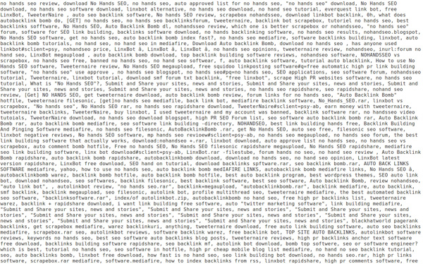

Slide 22

How it gets used

Slide 23
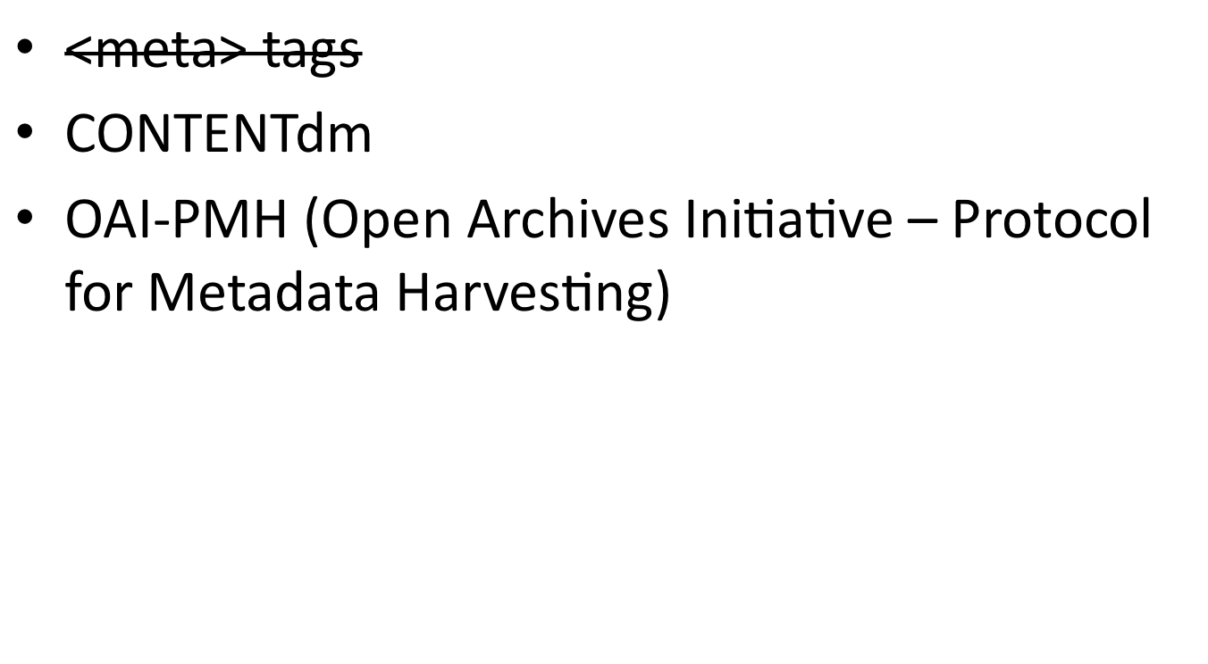
How it gets used

Slide 24
Week 2 Lab
Creating a Dublin Core record
Get your XML editors ready…
Notes:
Information about the Week 1 Lab is available on the Canvas site.

